Slide 1
[Pradarshana 2022] Best Project Presentation – Project work CSP
Multi-Factor based Nutrition Management System
and
Recipe Recommendation System
Team
Students:
1MS18CS025 - Aravind Shreyas Ramesh
1MS18CS040 - Dheeraj Bhat
1MS18CS043 - Divya
1MS18CS046 -Gaurav V
College Professor(s):
Dr. Shilpa Shashikant Chaudhari, Associate Professor
Date: 07 July 2022

Slide 2
PROBLEM STATEMENT
Nutrient management in the context of this project aims to quantize the consumption of essential nutrients in an efficient format such that it leads to a healthy and balanced lifestyle. Several recent studies have shown the importance of quality-based consumption of nutrients which could otherwise lead to serious health issues that could even be fatal at times.
Increased consciousness towards one’s health has recently been in the limelight which creates the need for an intelligent system specially customized for the individual that can analyse the person’s consumption quality and suggest options that could essentially fulfil their body’s need to lead a healthy lifestyle.
The presence of this particular system can hugely impact individuals as this would save a considerable amount of time in finding a recipe that would not only suit the user’s preference but also encapsulate all the nourishing factors that an individual would require.
Planned Expectations
Design a base solution.
Develop codebase to act as a proof of concept for the solution.
Build an application to showcase the effectiveness of solution provided.
Test in real time with users.
Notes:
-

Slide 3
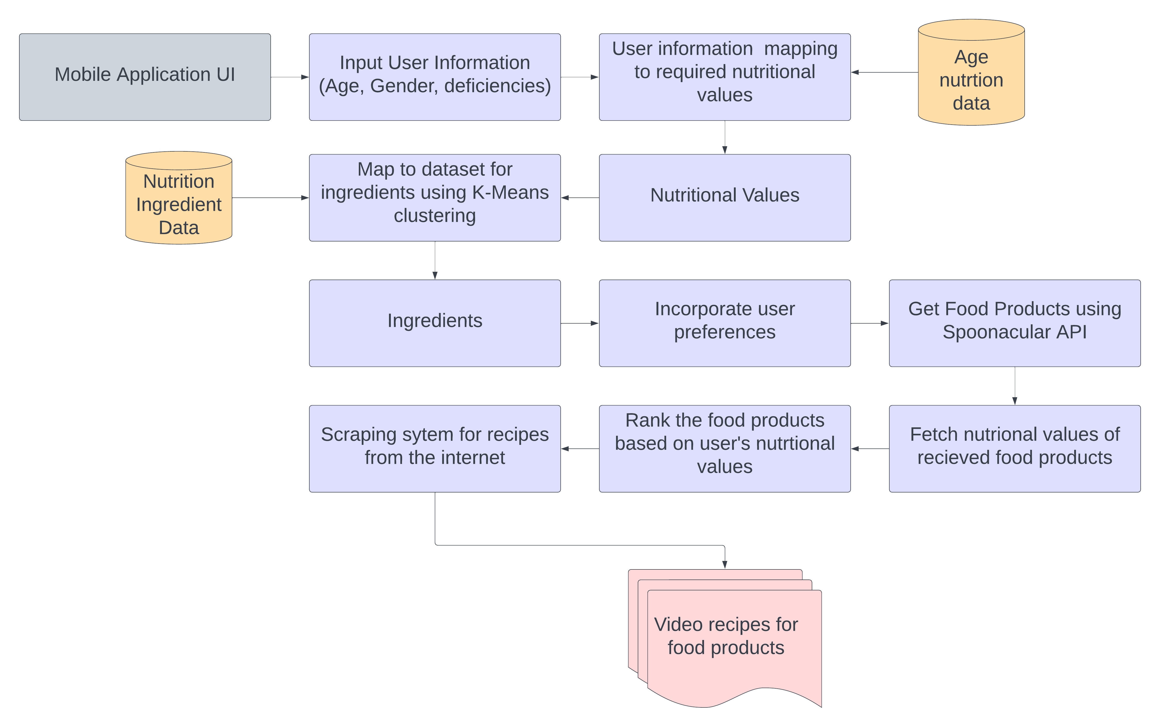
Approach / Solution
Concept Diagram :
( Clear detailed schematic / block diagram / flow chart depicting the proposed concept / solution )

Slide 4
Dataset(s) Analysis / Description
Dataset Capture / Preparation / Generation :
(Discuss the dataset generation process or if downloaded data provide details of what data & from where it was obtained etc… - 2 to 3 bullets only)
The two datasets for this research were sourced from National Institute of Nutrition, India.
One dataset refers to the recommended standard nutrition consumption for both men and women for various age groups.
The second dataset contains the nutrition composition of 335 unique commonly used ingredients.
Dataset Understanding / Analysis :
(Provide 2 to 3 bullets about what is your understanding of the data / opinion about the data)
Dataset one provides valuable information about the standard consumption values of each of the nutrients across age groups and gender in recommended units which helps in calculating a defined nutritional requirement set.
Dataset two provides the nutritional content in each ingredient for each nutrient present in dataset making it easy to identify ingredients that could fulfill the user’s nutritional requirement.
Dataset Pre-Processing / Related Challenges (if any) :
(List out the challenges you fore see in data handling wrt problem definition – 2 to 3 bullets only)
Several repeating ingredients/variants of ingredients were handled by averaging the nutritional content of these ingredients.
Removing fringe ingredients that do not appear in any of the recipes provided.

Slide 5
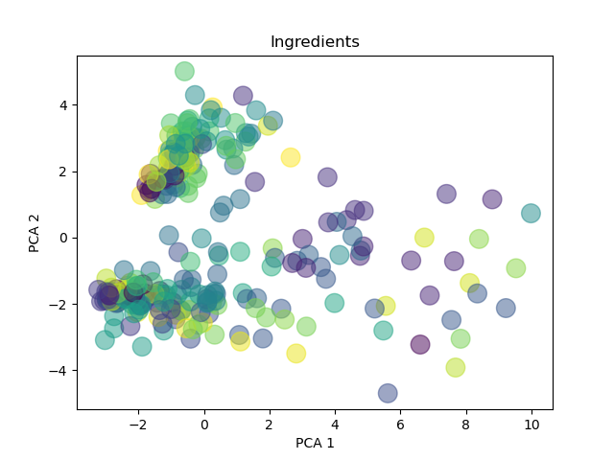
Experimental Results / Simulations / Observations
Results :
(provide numerical data / bar charts / plots / images / videos / tabulated results etc. Use full slide or multiple slides up to max 3 slides to demonstrate the results)
The image depicts the result of the clustering algorithm of ingredients 2D.
The visualization above comprises of 30 clusters with 10 data points (ingredients) in each cluster. There is no visible hyperplane in this 2D visualization that segregates the clusters because there exists numerous features (nutritional components) based on which its being clustered. We choose the cluster that contains the vector we appended ( deficiency vector) since it’ll have various ingredients that can cover the deficits and in turn be used to make some food product.
Fig. 1. Clustering of ingredients in 2D

Slide 6
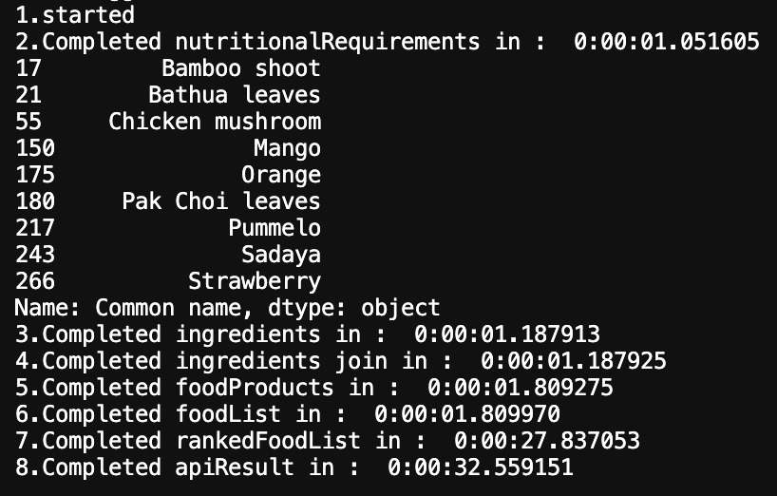
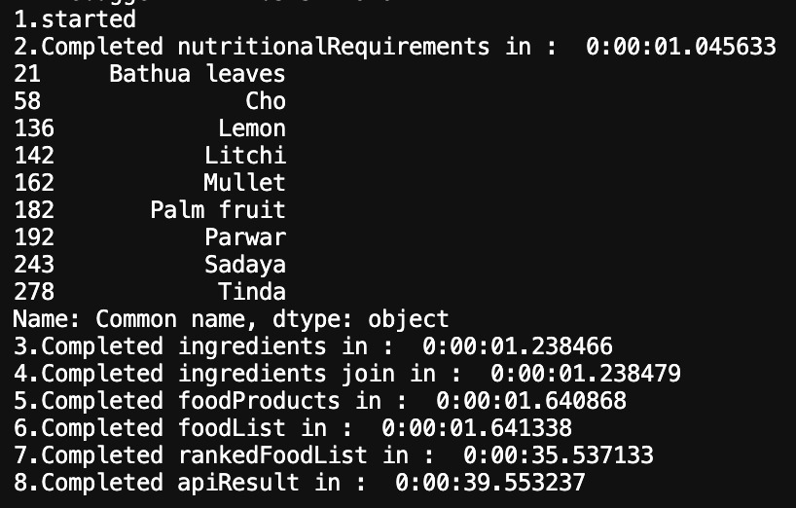
Experimental Results / Simulations / Observations
Results :
(provide numerical data / bar charts / plots / images / videos / tabulated results etc. Use full slide or multiple slides up to max 3 slides to demonstrate the results)
Fig. 2. Results of clustering
Fig. 3. Results of clustering
These image depicts the sample set of identified ingredients for a given set of nutritional requirement

Slide 7
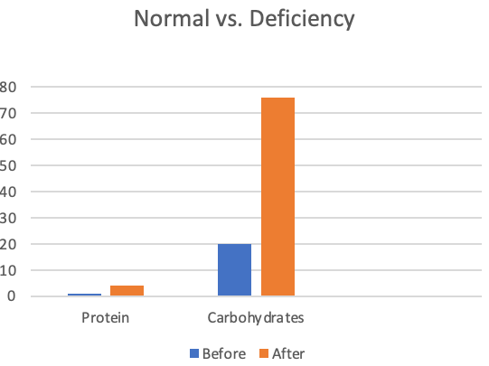
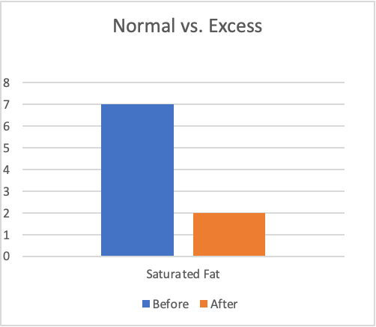
Experimental Results / Simulations / Observations
Results :
(provide numerical data / bar charts / plots / images / videos / tabulated results etc. Use full slide or multiple slides up to max 3 slides to demonstrate the results)
Normal vs. Deficiency graph shows the levels of protein that the engine recommends for a user without a deficiency vs. a user with a deficiency in protein and carbohydrates. As it is clearly visible, users with a deficiency are provided diets and recipes with ingredients which help in improving their intake for a given deficiency.
Normal vs. Excess shows the levels of saturated fat the engine recommends for a user that consumes a healthy diet vs. a user that consumes a fatty diet. As it is clearly visible, users who have an excess intake of a particular nutrient are provided diets and recipes with ingredients which help in reducing their consumption to have a good and healthy overall diet.

Slide 8
Experimental Results / Simulations / Observations
Major Observations / Conclusions & Challenges :
(provide details about your findings, experimental opinion – Use separate slide if necessary)
Conclusion
A solution was provided which revolves around identifying deficiencies, building clusters to identify required ingredients, assemble food products and rank them according to the user's needs.
An application was built to verify the solution in real-time.
The project will be handed over to TDU who will build on the existing solution.
Challenges faced
Finding reliable REST endpoints to get food products that cater to all necessary filters.
Efficient hyperparameters for web scraping of videos to not return unsuitable content.

Slide 9
Deliverable
Final Deliverables :
(Discuss in the form of bullets)
A novel base solution that tackles the problem statement.
Codebase to implement the base idea to verify the sanity of the said solution.
An application with enticing UI to serve as the frontend and a highly available backend..
Test in real time with users.
Handing over to TDU for the solution to be adapted/built upon.
Code : https://github.com/Gaurav-71/Multi-Factor-based-Nutrient-Management-and-Recipe-Recommendation-System
IP / Paper Publication Plan :
(Details of papers / patentable ideas / innovative aspects that can lead to patentable ideas)
Report submitted to Science of Computer Programming Journal highlighting the novel features in the solution provided

Slide 10
Thank you

